Slide 1
Profiling the BLAST bioinformatics application for load balancing on high-performance computing clusters
Trinity Cheng^{1,2}
Mentor: Mike Mikailov, PhD²
¹River Hill High School, Clarksville, Maryland
²U. S. Food and Drug Administration, Silver Spring, Maryland

Slide 2
Introduction
BLAST
The most widely used bioinformatics application
Problem
How to reduce runtime by optimally dividing BLAST data among multiple processors
Methods
Use profiling techniques to analyze BLAST bottleneck
Measure runtime vs. different input datasets
Characterize hardware performance for high-performance computing clusters
Create models to predict runtime
Use models to optimize data partitioning
Results
BLAST runtime reduced on HPC clusters
Discussion and Conclusion

Slide 3
Background
Basic Local Alignment Search Tool (BLAST) is a software package developed by NIH/NCBI for comparing biological sequences such as DNA or amino acid sequences
BLAST is probably the most widely used bioinformatics application
Original publication cited more than 94k times
"Google of biological research"
BLAST identifies matches between two user input files:
(a) Database and (b) Query
Input files usually millions of sequences long and can be > 100 GB each
BLAST is suitable for high performance computing (HPC)
Parallel BLAST were developed: mpiBLAST, ScalaBLAST, DCBLAST, miBLAST, etc.
Parallelization of BLAST on HPC is an important research area

Slide 4
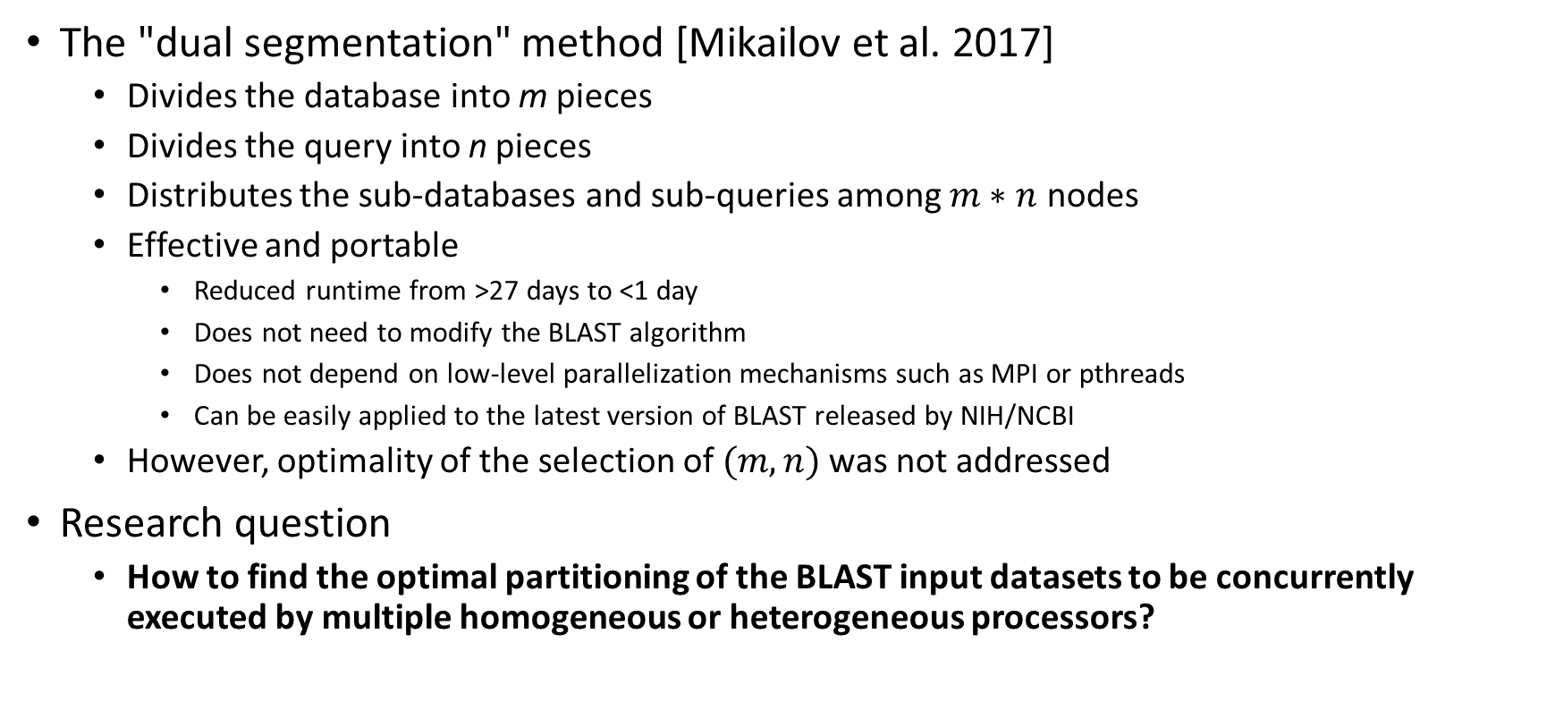
Problem Formulation
The "dual segmentation" method [Mikailov et al. 2017]
Divides the database into m pieces
Divides the query into n pieces
Distributes the sub-databases and sub-queries among $m∗n$ nodes
Effective and portable
Reduced runtime from >27 days to <1 day
Does not need to modify the BLAST algorithm
Does not depend on low-level parallelization mechanisms such as MPI or pthreads
Can be easily applied to the latest version of BLAST released by NIH/NCBI
However, optimality of the selection of $(m,n)$was not addressed
Research question
How to find the optimal partitioning of the BLAST input datasets to be concurrently executed by multiple homogeneous or heterogeneous processors?

Slide 5
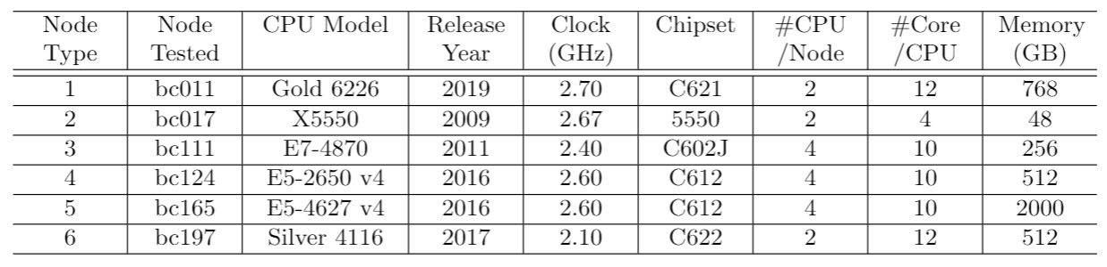
Methodology
Three profiling techniques were used to analyze BLAST bottlenecks
Shell-level: Unix "time" command – for fast overall runtime measurement
Code-level: BLAST built-in module "profiler" – for fast "hotspot" runtime measurement
System-level: Unix "gprof" program – for detailed per-function time/call-count measurement
Measure runtime vs. different input datasets
6 different database files from 8,179 to 261,725 sequences
15 different query files from 17,848 to 1,142,220 sequences
Characterize hardware performance for high-performance computing clusters
FDA "Betsy" HPC cluster: ~500 nodes, 6 types of hardware configurations
Use models to optimize data partitioning
Use bivariate quadratic functions to fit the measured data
Table: Hardware specifications of the FDA "Betsy" HPC nodes

Slide 6
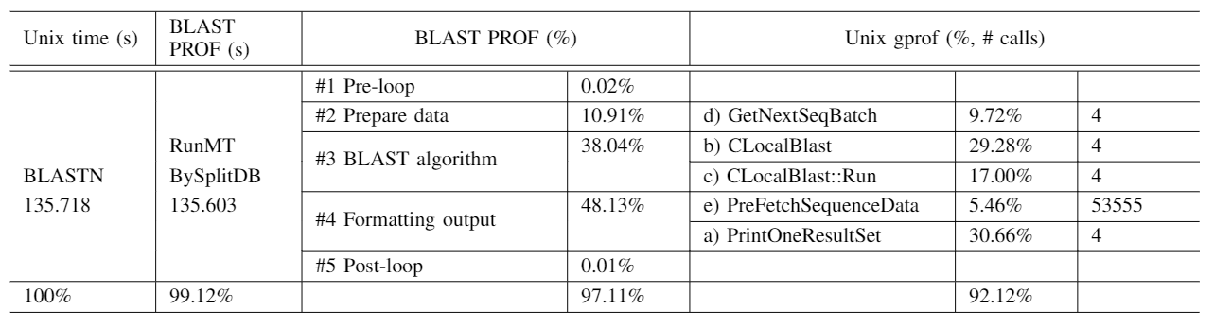
Results – Bottleneck
BLASTN calls more than 34,500 functions
One function (RunMTBySplitDB) takes 99.12% of the total runtime
Of its 53 child functions, only five (in orange box) take 92.12% of total runtime
The five most time-consuming functions need to be investigated in detail

Slide 7
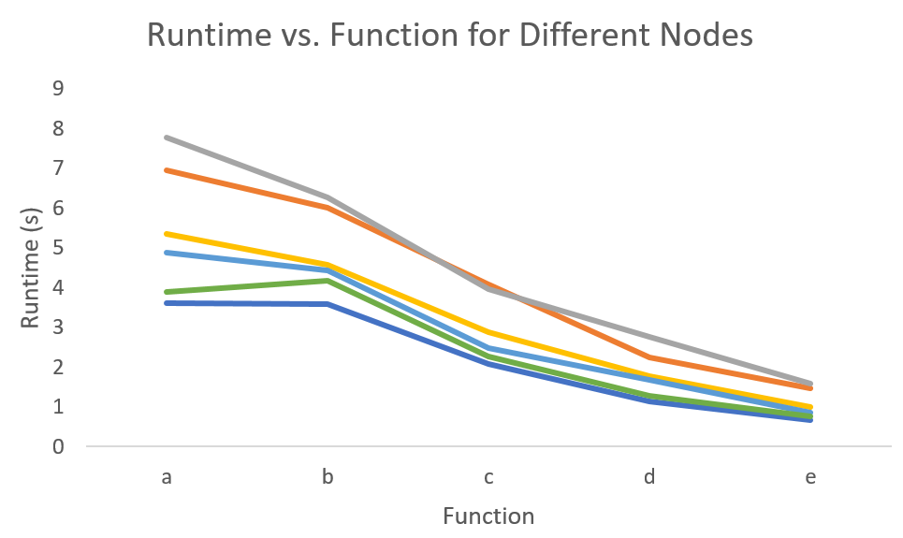
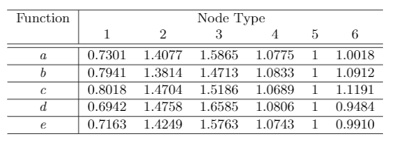
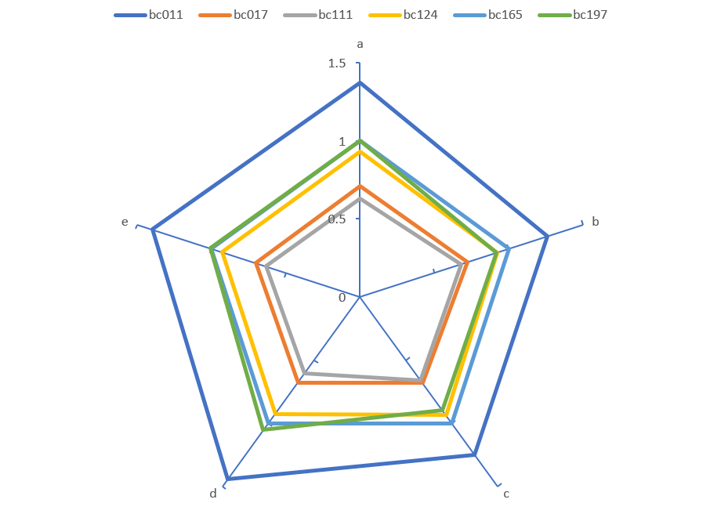
Results – Hardware Performance
Per-function runtime measured for 6 different hardware configurations shown in line chart
Normalized runtime shown in table
Normalized performance shown in radar chart
Per-function performance varies among different nodes
Slowest node can take >50% longer than fastest node
Node performance cannot be predicted by just specifications

Slide 8
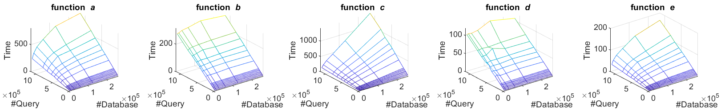

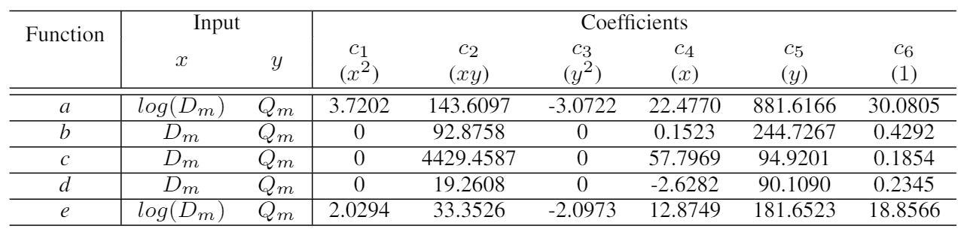
Results – Modeling
Runtime plotted as a function of database size and query size
Modeled as bivariate quadratic:
a and e modeled with a saddle-like surface, which descends faster in the #query dimension
b and d modeled with a plane, proportional to #query only
c modeled with a plane, proportional to #database*#query

Slide 9
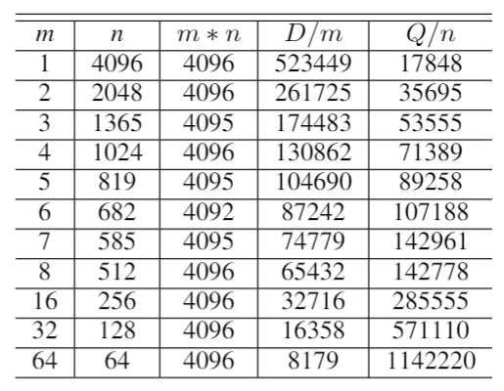
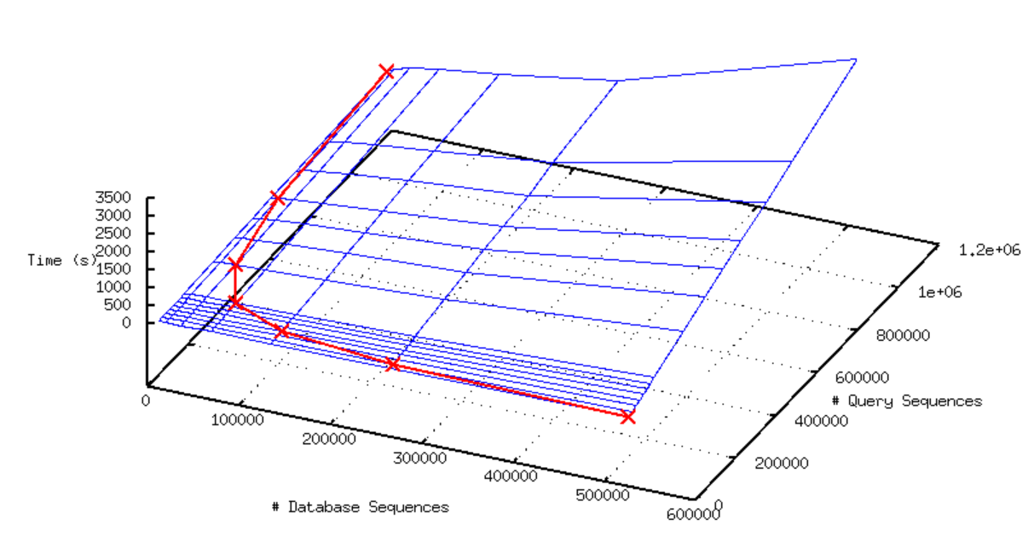



Results – Optimal Partitioning
$$D=523,449, Q=73,102,023$$
Given a BLAST job of D database sequences and Q query sequences
Given an HPC cluster of $P=m∗n$ nodes to run the BLAST job
Dual segmentation method [Mikailov et al. 2017]
Database divided into pieces of size $D/m$
Query divided into pieces of size $Q/n$
Each of node executes a sub-job of ($D/m$, $Q/n$)
How to find the optimal ($D/m$, $Q/n$)
Find all possible (m,n) by factoring P (a hyperbolic curve)
Utilize the runtime model for the specific hardware
Project the hyperbolic curve onto the runtime model (blue mesh) to define the solution space (red curve)
Find the minimum f(m,n) alone the red curve
In this case the optimal (m,n) is (2,2048)
Optimal solution

Slide 10
Discussion
The proposed methodology can be used in the other applications in the BLAST+ suite or any other application with source code provided.
The tested database and query files may or may not represent the common use case of BLAST applications, if one exists.
The measured runtime was decomposed into five components that can be well-fitted by bivariate quadratic functions. The other applications may not exhibit the same property.
The system-level profiler “gprof” is powerful but extremely time-consuming to generate and analyze. The measured runtime may be distorted because of the profiling overhead.
The model accuracy may depend on other factors such as runtime workload, cache mechanism for the file system, job schedulers, etc. in the HPC cluster.

Slide 11
Conclusion
In BLASTN, five of its 34,000+ functions cover 92% of the overall runtime.
Different database and query files were tested to measure the BLASTN runtime.
Simple quadratic polynomials were used to model runtime of five critical functions accurately.
Reducing query size is usually more effective than reducing database.
Profiler “gprof” can be used to identify critical functions of an application.
Modeling node performance differences can help with load balancing in HPC clusters.

Slide 12
Acknowledgments
This project was supported in part by an appointment to the Research Participation Program at the U.S. Food and Drug Administration administered by the Oak Ridge Institute for Science and Education through an interagency agreement between the U.S. Department of Energy and the U.S. Food and Drug Administration.
The authors thank Dr. Pei-Ju Chin, Dr. Kenny Cha, Dr. Arifa Khan, Mr. Stuart Barkley, and Mr. Fu-Jyh Luo for their guidance and advice.
The mention of any commercial products herein is not to be construed as either an actual or implied endorsement of such products by the Department of Health and Human Services. This is a contribution of the US Food and Drug Administration and is not subject to copyright.

